Slide 1

Safety of Expressions and Equivalence of Relational Query Languages
Database Management System | Relational Model and Formal Query Languages
Course: Database Management System | Chapter: Relational Model and Formal Query Languages | Program: Bachelor of Engineering
DISCOVER · LEARN · EMPOWER
Notes:
Welcome everyone to today's lecture on the safety of expressions and equivalence in relational query languages. We will explore why safety is crucial for preventing infinite loops in database queries. This session builds directly on our previous understanding of relational algebra and calculus. Let us begin by mapping our learning outcomes to the course goals.

Slide 2
Course Outcomes
SLIDE 2 / 14
Course Outcome
CO | BT LEVEL | DESCRIPTION
CO1 | BT2 | Explain database architecture, relational model concepts and formal query language foundations including relational algebra and relational calculus.
CO2 | BT3 | Apply relational algebra, relational calculus and SQL constructs to formulate correct and efficient database queries.
CO3 | BT4 | Analyze functional dependencies and design normalized relational schemas up to 5NF ensuring lossless join and dependency preservation.
CO4 | BT4 | Analyze transaction schedules and concurrency control mechanisms to determine serializability, recoverability and correctness.
CO5 | BT5 | Evaluate storage structures, indexing strategies and query optimization techniques for performance, scalability and reliability.
Chandigarh University
2 / 14
Notes:
Today's lecture directly addresses CO1 by explaining the foundations of formal query languages and their safety constraints. We also touch upon CO5 because understanding query equivalence is the first step in optimizing query execution plans. Without safe expressions, a query optimizer cannot function correctly, leading to system crashes. This ensures our students understand both the theoretical and practical implications of these concepts.

Slide 3
Learning Objectives
SLIDE 3 / 14
Learning Outcomes
1
Define the concept of a safe relational expression in formal query languages.
2
Identify the conditions required for a relational calculus expression to be safe.
3
Demonstrate the difference between safe and unsafe expressions using examples.
4
Explain the criteria for equivalence between relational algebra and calculus queries.
5
Analyze how safety constraints impact query execution and system reliability.
Chandigarh University
3 / 14
Notes:
By the end of this session, you will be able to define what makes a query safe versus unsafe. You will learn to identify specific conditions that prevent infinite results in relational calculus. We will also look at how different query languages can produce the exact same result, which is known as equivalence. Finally, we will discuss why these theoretical concepts matter for real-world database performance.

Slide 4
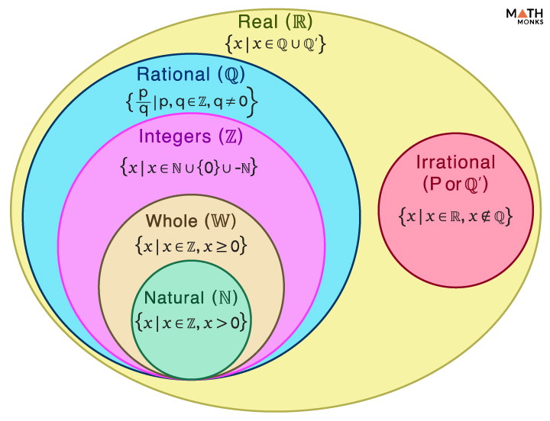
Lecture
SLIDE 4 / 14
The Problem of Unbounded Results
1
Relational calculus allows variables to range over the entire infinite domain of possible values.
2
An unsafe expression can generate an infinite number of tuples in the result set.
3
This occurs when the query asks for values not present in the database relations.
4
The system cannot terminate the query execution if the result set is infinite.
5
Safety constraints restrict variables to values actually found in the database relations.
6
Without safety, the query language is not practically usable for database management.
7
Safety ensures that every query returns a finite set of tuples.
Finite and Infinite Sets - Definition, Examples, and Cardinality
Chandigarh University
4 / 14
Notes:
Imagine a query asking for all students who do not exist in the database. In pure relational calculus, the variable could range over every possible name in the universe. This leads to an infinite result set that the computer can never finish processing. Safety constraints solve this by limiting the search space to only the data currently stored in the database relations.

Slide 5
Lecture
SLIDE 5 / 14
Definition of a Safe Expression
1
A relational expression is safe if its result contains only values from the database.
2
Every variable in the expression must be bound to a finite set of values.
3
The result set must be a subset of the active domain of the database.
4
Active domain includes all values currently appearing in the database relations.
5
Safety guarantees that the query will always terminate with a finite result.
6
It prevents the evaluation of conditions that could yield infinite tuples.
7
Safe expressions are the standard requirement for all practical query languages.
Chandigarh University
5 / 14
Notes:
A safe expression is defined by the fact that its result is a subset of the active domain. The active domain consists of all values currently stored in the database tables. If a query tries to return a value not in this domain, it is considered unsafe. This definition ensures that no matter what the query asks, the computer can always find the answer within the existing data.

Slide 6
Lecture
SLIDE 6 / 14
Conditions for Safety in Calculus
1
Every variable in the target expression must appear in a positive atom.
2
Variables in the condition part must also be bound to existing values.
3
A variable is bound if it appears in a relation or a comparison.
4
Unbound variables can range over the infinite domain and cause errors.
5
Safety requires that all variables are restricted to the active domain.
6
The condition must not allow variables to take arbitrary infinite values.
7
Checking safety involves analyzing the binding of every variable in the query.
Chandigarh University
6 / 14
Notes:
To ensure safety, we must check every variable in the query. A variable is considered bound if it appears in a relation or a comparison with a constant. If a variable is not bound, it can take any value from the infinite domain. This leads to the generation of infinite tuples, which is why we must enforce binding conditions for all variables.

Slide 7
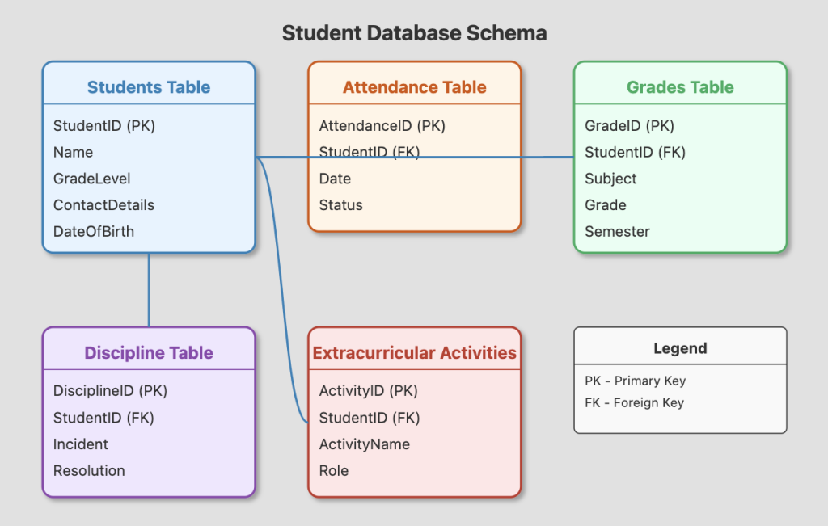
Worked Example
SLIDE 7 / 14
Safe Expression
GOVERNING EQUATION
Expression: {S.name | Student(S) ∧ S.course = 'CS101'}
QUERY
Find names of students who have taken course 'CS101'.
• Variable S is bound by the relation Student(S) in the formula.
• The result contains only names present in the Student relation.
• The active domain limits the search to existing student records.
• This expression is safe because S cannot range over infinite values.
• The result is a finite set of names from the database.
Source: five.co
Chandigarh University
7 / 14
Notes:
Consider a query to find students who took a specific course. Here, the variable S is bound by the relation Student(S). This means S can only take values that actually exist in the Student table. The result will be a finite list of names, making the expression safe. This is the standard form of a safe query in relational calculus.

Slide 8
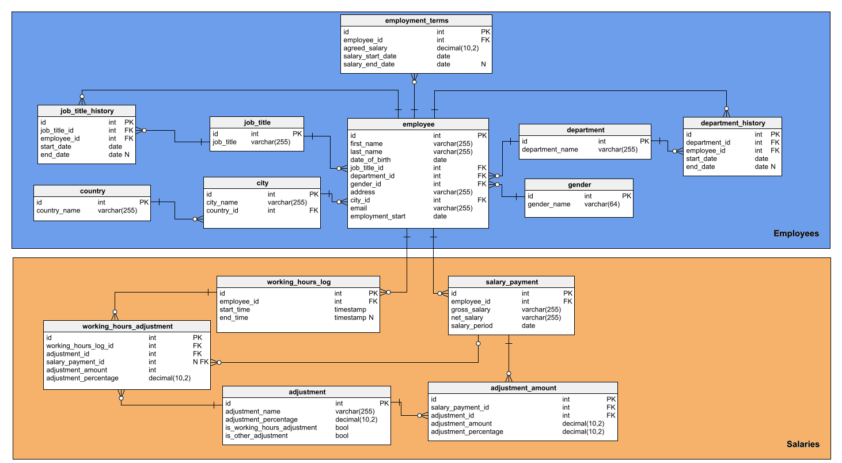
Worked Example
SLIDE 8 / 14
Unsafe Expression
QUERY
Find all names not in the Student relation.
EXPRESSION
{S.name | ¬Student(S)}.
• Variable S is not bound to any relation in the condition.
• S can range over all possible names in the infinite domain.
• The result includes every name not currently in the database.
• This creates an infinite set of tuples that cannot be computed.
• The expression is unsafe because it lacks a binding condition.
Source: www.red-gate.com
Chandigarh University
8 / 14
Notes:
Now consider a query asking for names not in the database. The variable S is not bound to any relation, so it can range over every possible name. This results in an infinite set of tuples, which the system cannot process. This is a classic example of an unsafe expression that violates the safety constraints.

Slide 9
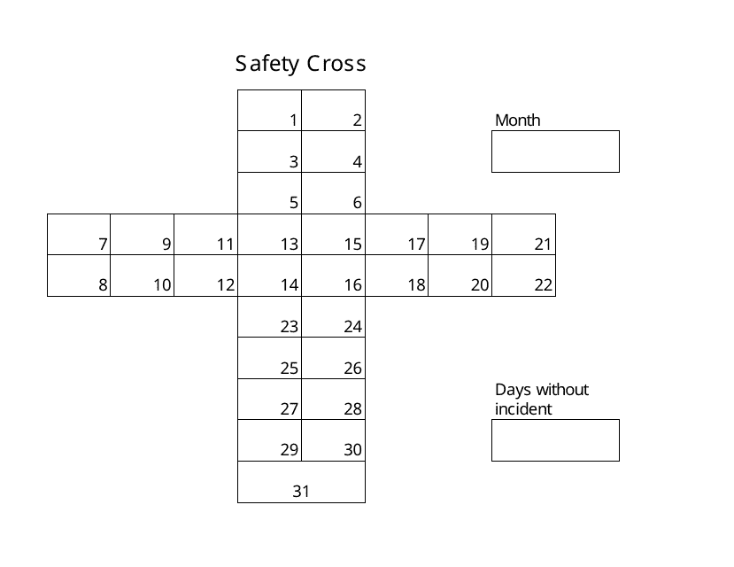
Lecture
SLIDE 9 / 14
Common Pitfalls in Safety Checks
1
Assuming that a negation operator always creates a safe expression.
2
Overlooking variables that appear only in the condition part of the query.
3
Confusing the active domain with the entire universe of possible values.
4
Failing to check if all variables are bound in every branch of logic.
5
Neglecting to verify safety in complex nested query structures.
6
Believing that a query is safe just because it returns a result.
7
Ignoring the impact of domain values on query termination.
Source: data.templateroller.com
Chandigarh University
9 / 14
Notes:
Students often make the mistake of thinking that negation always creates a safe expression. However, negation without a binding condition can lead to infinite results. Another common pitfall is overlooking variables that appear only in the condition part. It is crucial to verify that every variable is bound to the active domain in all parts of the query.

Slide 10
Lecture
SLIDE 10 / 14
Equivalence of Query Languages
1
Two queries are equivalent if they produce the same result for all databases.
2
Relational algebra and relational calculus are equivalent in expressive power.
3
Any query in relational calculus can be rewritten as relational algebra.
4
Any query in relational algebra can be rewritten as relational calculus.
5
Equivalence ensures that the choice of language does not limit functionality.
6
It allows database systems to optimize queries across different representations.
7
Equivalence is a fundamental property of the relational model.
Chandigarh University
10 / 14
Notes:
Equivalence means that two different queries produce the exact same result for any given database. Relational algebra and relational calculus are equivalent in expressive power. This means you can rewrite any query from one language into the other without losing functionality. This property is crucial for database systems to optimize queries regardless of the language used.

Slide 11
Demonstrating Equivalence
SLIDE 11 / 14
Selection
GOVERNING EQUATION
Algebra: σ_{A=5}(R) selects tuples
attribute A equals 5.
CALCULUS
{t | R(t) ∧ t.A = 5} selects tuples where A equals 5.
• Both expressions return the same subset of relation R.
• The algebraic operator σ corresponds directly to the calculus condition.
• This demonstrates the equivalence of selection operations in both languages.
• The result set is identical for any input relation R.
• Equivalence holds for all basic selection operations.
Chandigarh University
11 / 14
Notes:
Let's look at the selection operation. In relational algebra, we use the σ symbol to select tuples where a condition is true. In relational calculus, we use a similar condition within the set notation. Both expressions return the exact same subset of the relation. This demonstrates that the selection operation is equivalent in both languages.

Slide 12
Demonstrating Equivalence
SLIDE 12 / 14
Projection
ALGEBRA
π_{A,B}(R) projects attributes A and B from relation R.
CALCULUS
{t[A,B] | R(t)} projects attributes A and B from R.
• Both expressions return the same set of tuples with specific attributes.
• The algebraic projection operator corresponds to the calculus tuple variable.
• The result set is identical for any input relation R.
• Equivalence holds for all basic projection operations.
• This confirms the expressive power of both languages is equal.
Chandigarh University
12 / 14
Notes:
Now consider the projection operation. In algebra, we use the π symbol to select specific columns. In calculus, we specify the attributes we want in the tuple variable. Both expressions return the same set of tuples with the selected attributes. This confirms that the projection operation is also equivalent in both languages.

Slide 13
Lecture
SLIDE 13 / 14
Key Takeaways
1
Safety ensures queries return finite results by restricting variables to the active domain.
2
Unsafe expressions can lead to infinite loops and system crashes.
3
All variables in a query must be bound to existing database values.
4
Relational algebra and calculus are equivalent in expressive power.
5
Any query in one language can be rewritten in the other.
Chandigarh University
13 / 14
Notes:
To summarize, safety is essential for ensuring that queries return finite results. Unsafe expressions can lead to infinite loops and system crashes. All variables must be bound to existing database values to be safe. Finally, relational algebra and calculus are equivalent in expressive power, allowing for flexible query optimization.

Slide 14
Lecture
SLIDE 14 / 14
References
1
Fundamentals of Database Systems — Ramez Elmasri & Shamkant B. Navathe
2
Database System Concepts — Silberschatz, Korth & Sudarshan
3
Database Management Systems — Raghu Ramakrishnan & Johannes Gehrke
4
Oracle/MySQL Documentation — Oracle
Chandigarh University
14 / 14
Notes:
For further reading, I recommend the textbooks by Elmasri and Navathe, as well as Silberschatz, Korth, and Sudarshan. These books provide comprehensive coverage of the relational model and query languages. The documentation from Oracle and MySQL also offers practical insights into implementing these concepts. Please review these resources to deepen your understanding of the material.

